Slide 1


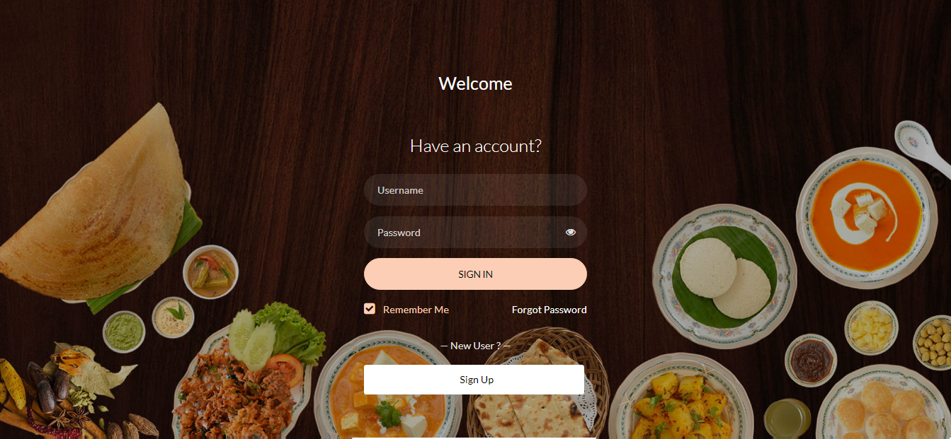
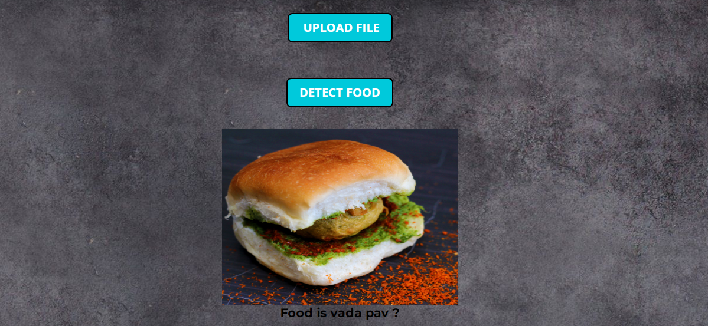

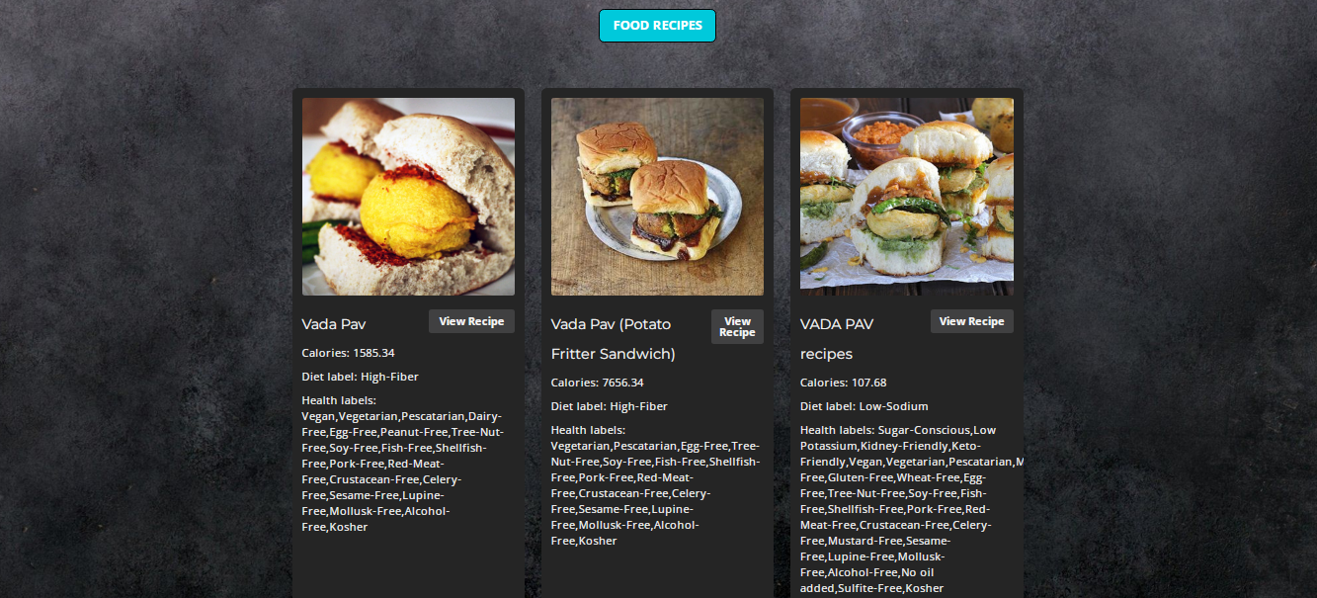

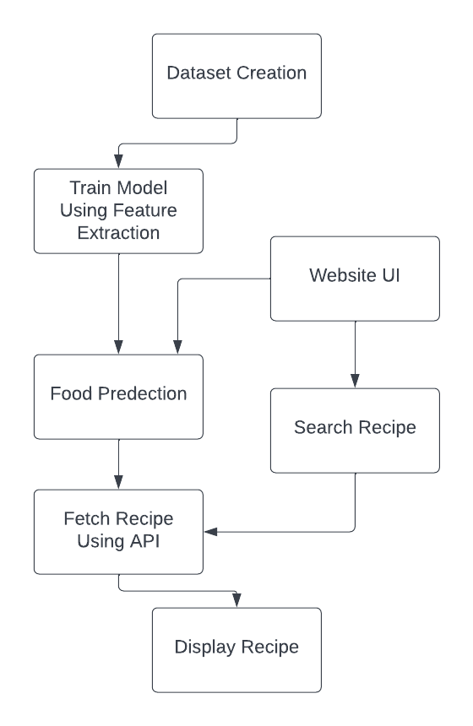
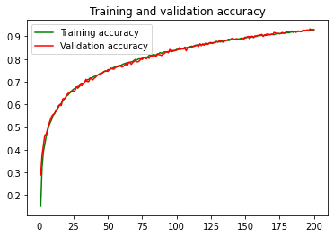
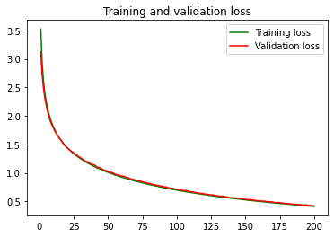
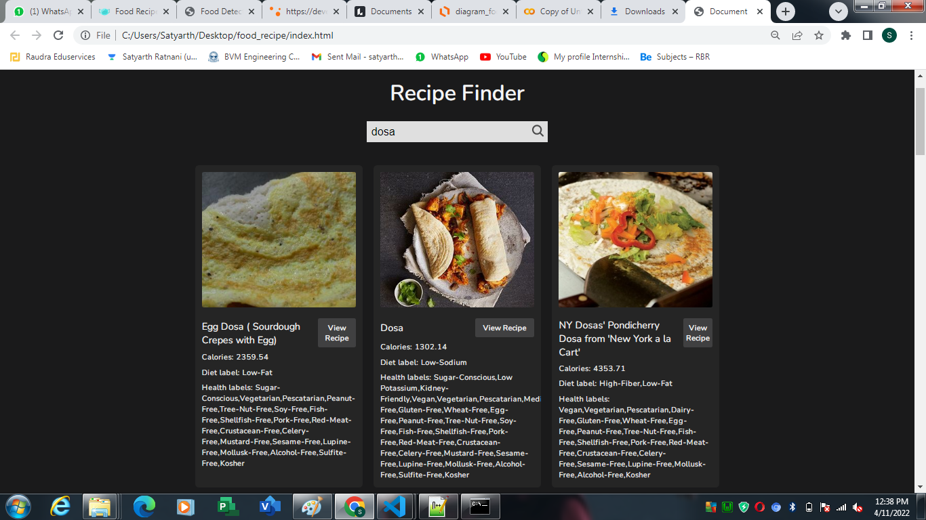
MyPlate - Food Recipe Generator System
INFORMATION AND TECHNOLOGY DEPARTMENT
BIRLA VISHVAKARMA MAHAVIDYALAYA ENGINEERING COLLEGE (An Autonomous Institution)
Subject: Project - II (4IT32)
Abstract
Project Modules
Login Page
Food detection
The system accurately detects the food item from image with its recipe and it also provides recipe by search option, with an attractive website interface.
Authentication
User profile
Preprocessing
Recipe by Name : Enter the name of food on search bar and you can see its recipe.
Recipe by Image : You can upload the image of food and its generate the recipe of food.
Introduction
Sometimes people are in a state of dilemma that how to make a food which are delicious in taste and don't know about recipe of food item.
we have designed one stop solution where you can just put image of dish you want to make or just enter the name of that recipe and by proceeding further you would get the steps to make that recipe.
Project Implementation
Dataset creation
Created our own dataset of Indian food items which contains 50 food items and in each we have 150 images of that food.
Home page
Food recipe
Training model
For training and testing we are using 70% images to train set
For feature extraction from the images we used VGG16 which is a convolutional neural network model.
We trained our model using various pre trained models like mobilenetV2, InceptionV3, Resnet50.
Detection from Image
Flow chart
Technologies
Food recipe by search
Back-end: Python, Django framework
Front end: HTML, CSS, JavaScript, Bootstrap
Database: MySQL
Dataset creation : Image assistant batch extension
Testing model
For testing we used 30% images from dataset. By comparing all trained models we got maximum accuracy using mobilenetV2.
Conclusion and future work
As we planned and discussed to explore various related datasets and perform data preprocessing in order to extract the desired attributes and also perform model training using Machine Learning or Deep Learning algorithms to find the food name and its recipe through Edamam’s API.
In future we will add more images in our dataset to get more accuracy. Also add some feature like favourite recipe, comment on post, rating of recipe.
Recipe Search API
Edamam's Recipe Search API lets you integrate recipes and faceted recipe search into your websites or mobile applications.
Guided by – Prof. Aneri Patel
Made by :
18IT444 – Ratnani Satyarth 18IT458 – Thakkar Kishan 18IT463 – Patel Shubham 18IT464 – Patel Keyur

